Slide 1
Sales Dashboard — Sample Superstore
Shaik Samrin

Slide 2
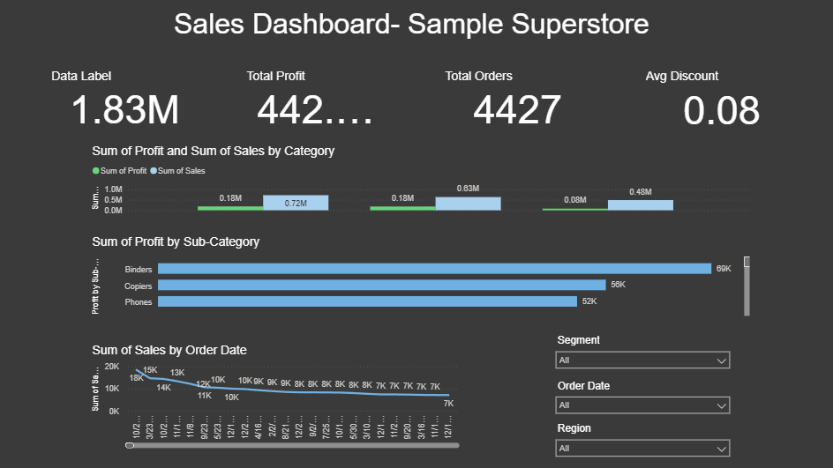
Dashboard

Slide 3
Key Insights & Actions
1. Top Category: Technology has the highest sales → Maintain stock & promotions.
2. Profit Issue: Tables sub-category has negative profit → Review discount and cost structure.
3. Seasonality: Sales spike in [Month] → Plan inventory & marketing accordingly.

